Slide 1
R Programming
CA-4 Project presentation
AADITHYA PRABHA R E0321008
SRI RAKSHA S E0321062

Slide 2
About the dataset
Red Wine Quality
The pH level of a wine can affect its taste and mouthfeel
Wines with lower pH levels tend to have a sharper, more acidic taste, while those with higher pH levels may taste smoother and less acidic.
The alcohol content in wine can also impact the aging potential of a wine and higher alcohol content wine will age faster.
In this dataset we have both wine pH and alcohol of different bottles of wine.
We are going analysis the ph and alcohol of red wine for improvising the wine quality.

Slide 3
OBJECTIVE
In this dataset we have both wine pH and alcohol of different bottles of wine.
We are going analysis the ph and alcohol of red wine for improvising the wine quality.

Slide 4
BASIC ANALYSIS OF DATASET

Slide 5
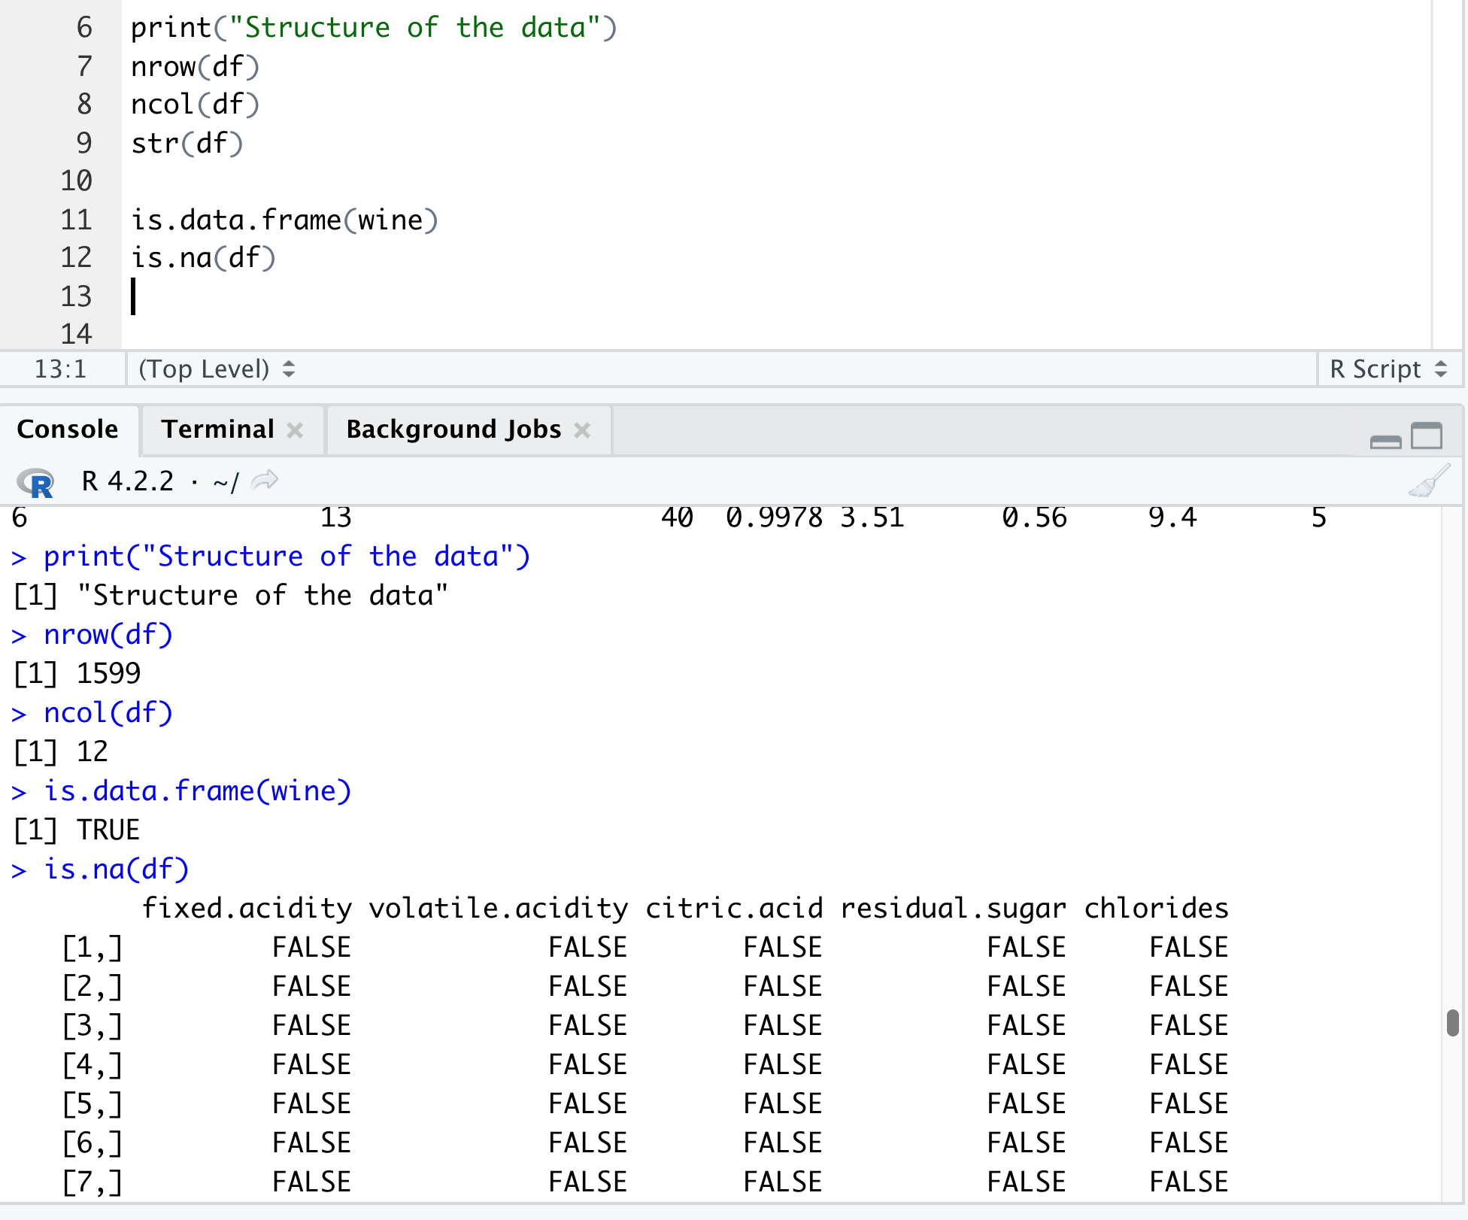
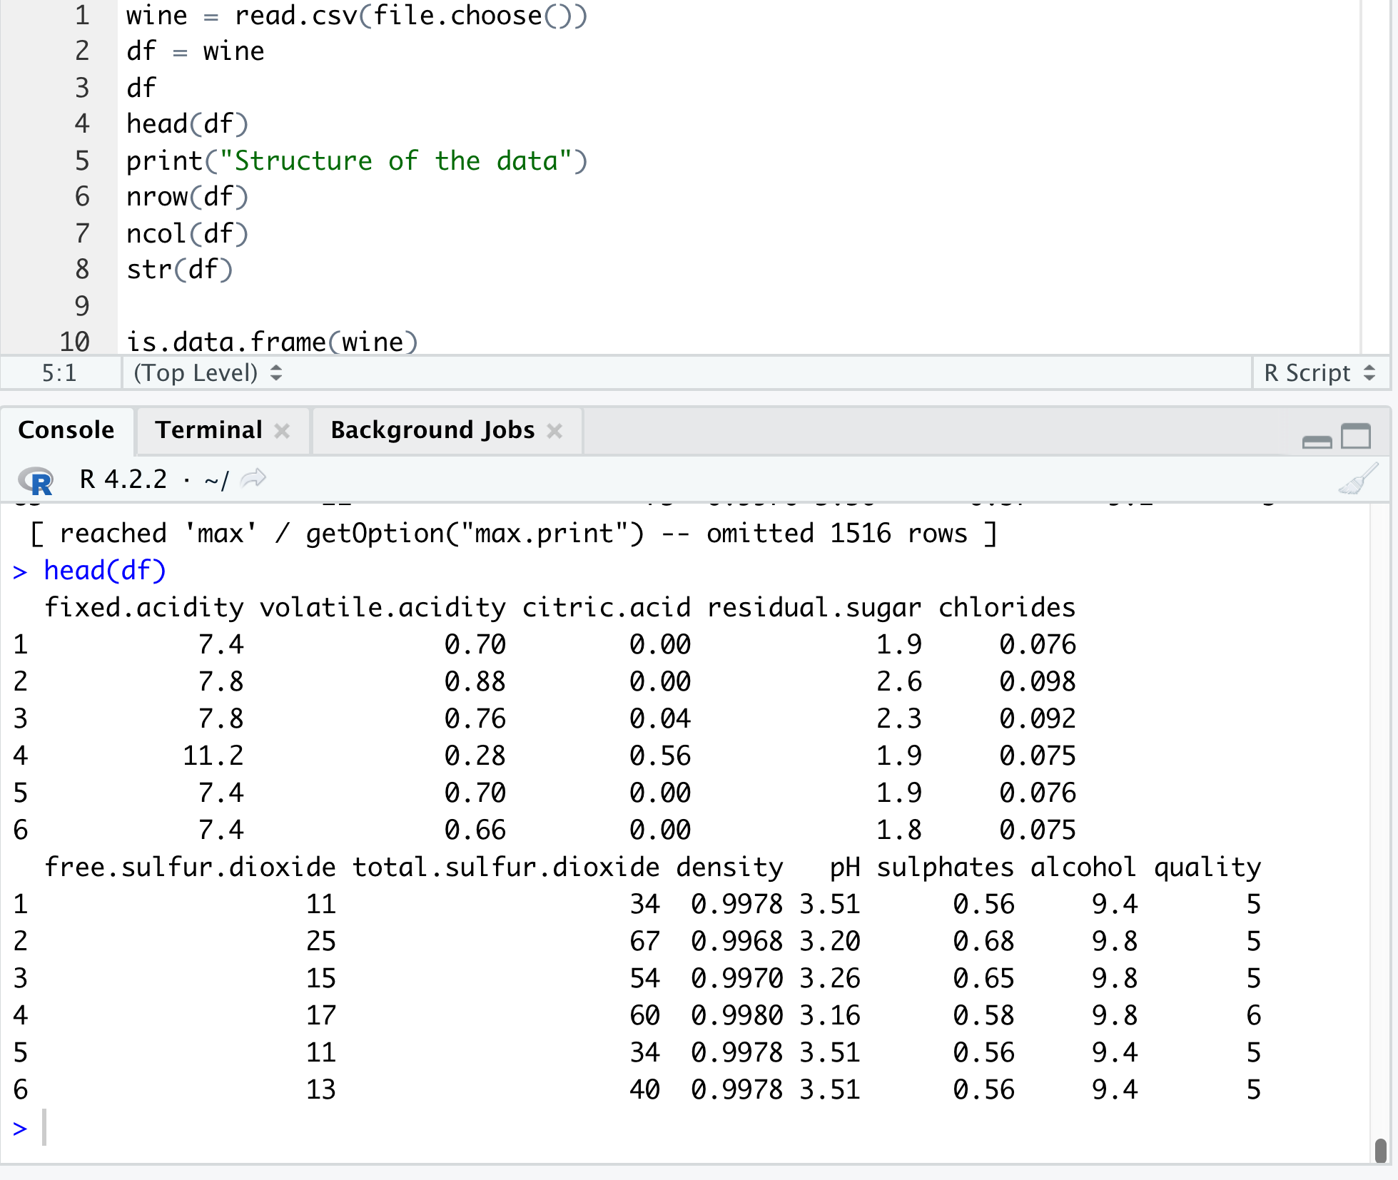
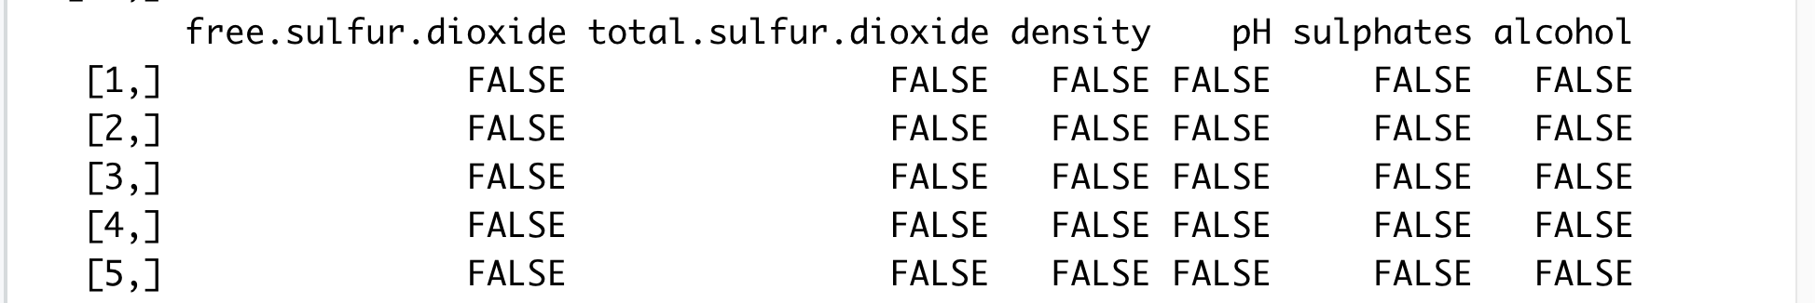
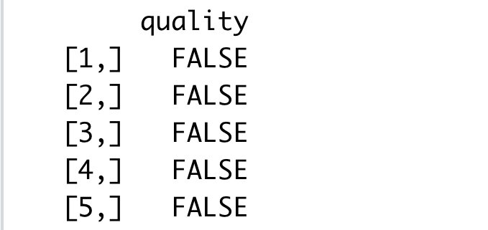

Slide 6
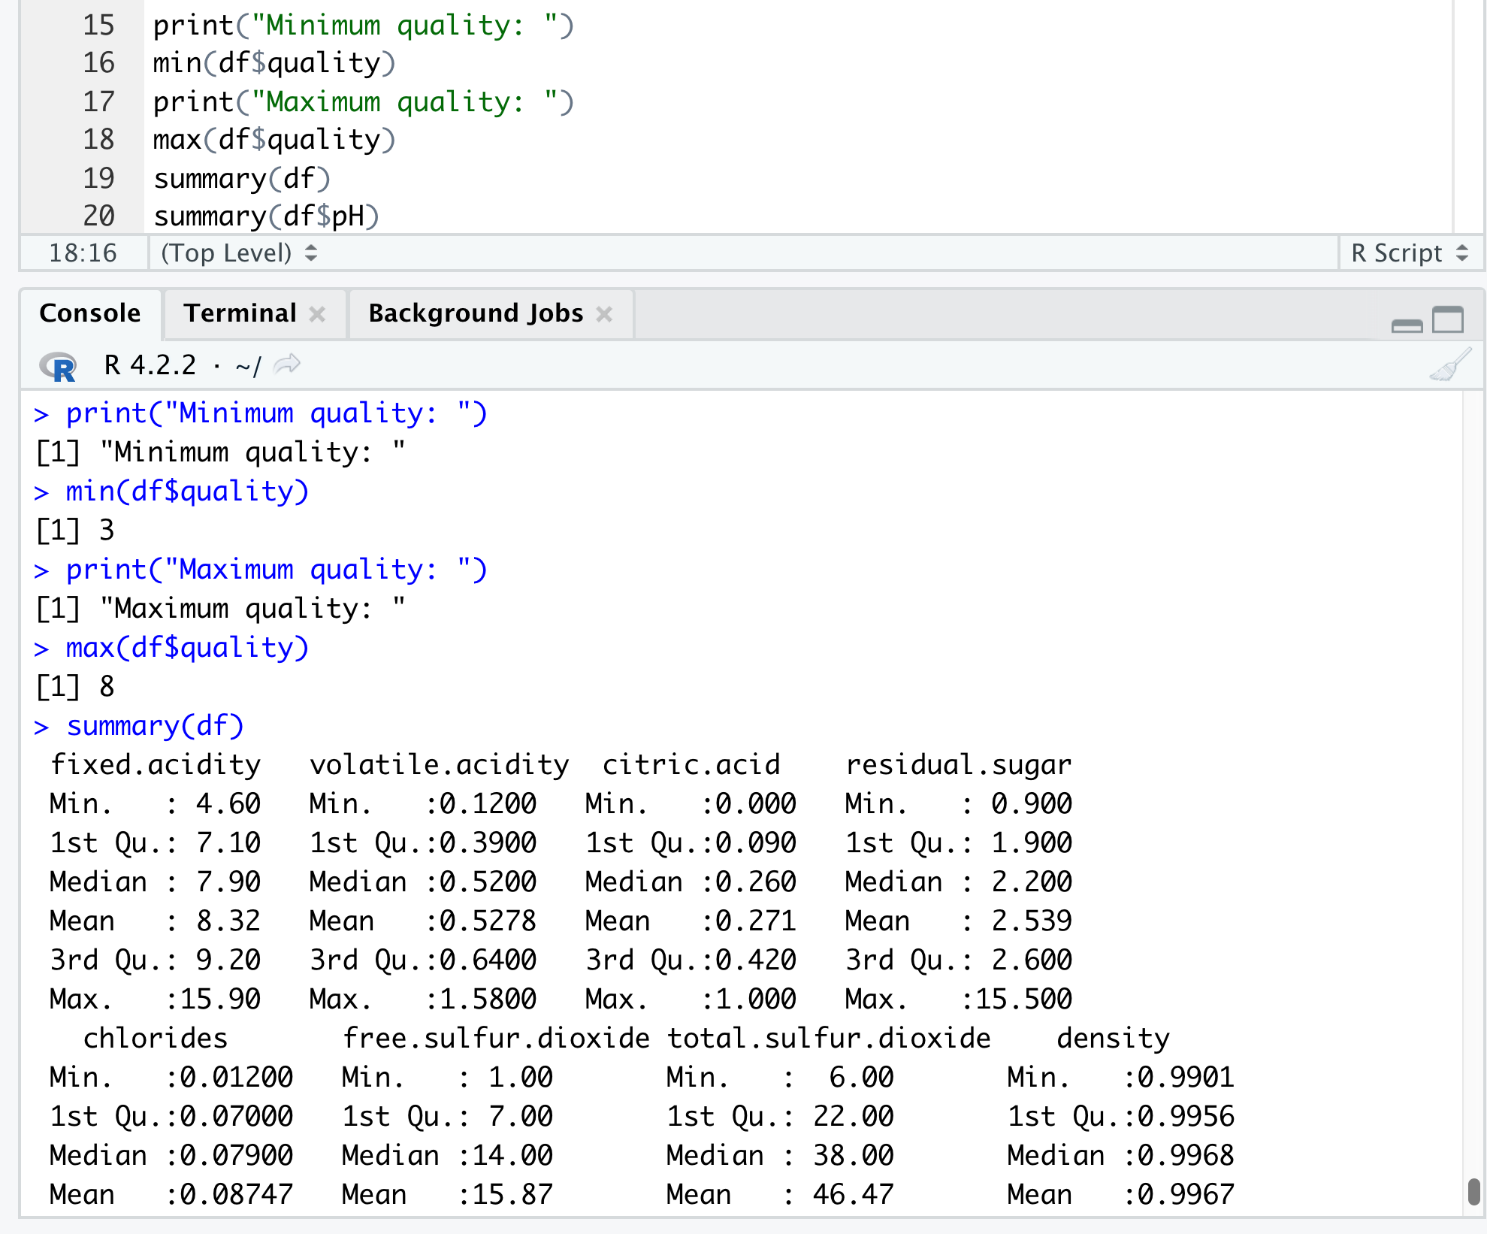
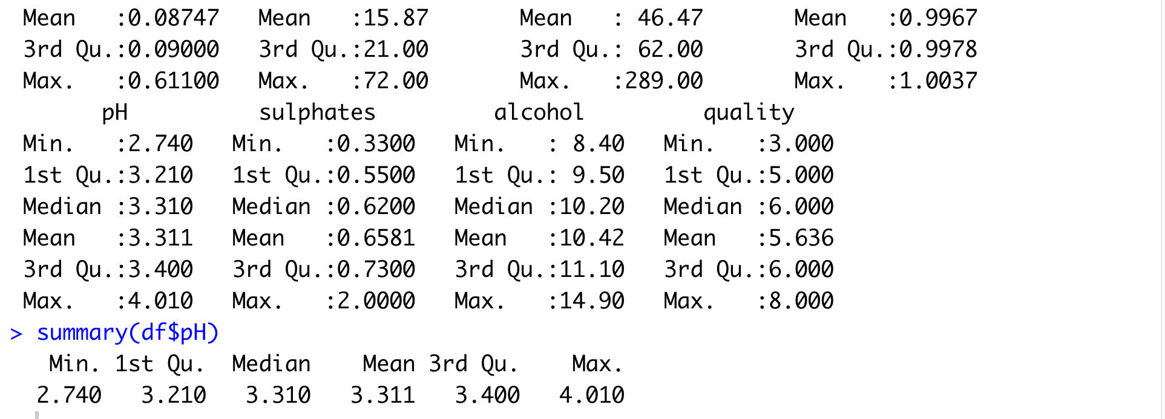
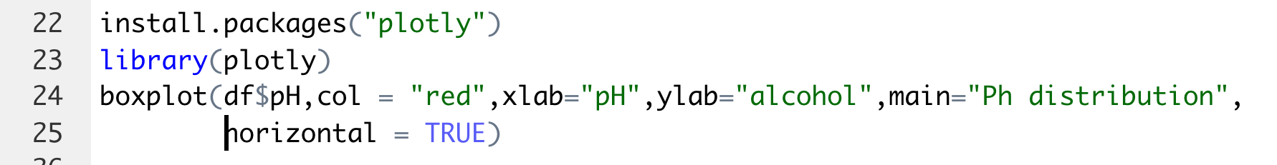

Slide 7
MACHINE LEARNING
ALGORITHM

Slide 8
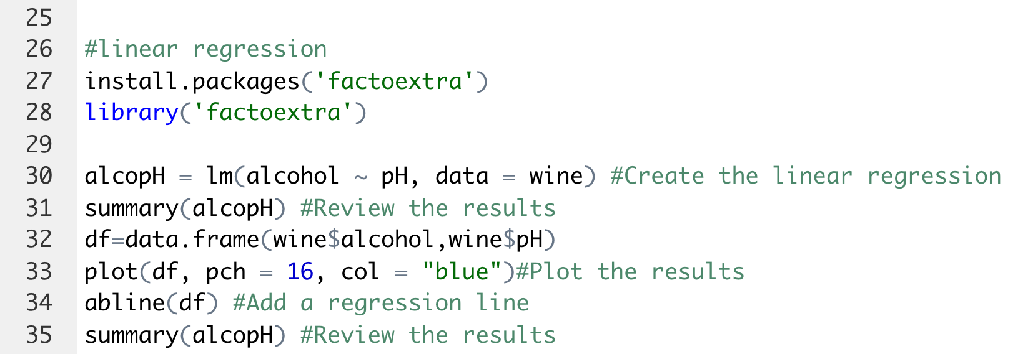
LINEAR REGRESSION
Linear regression is a statistical method used to model the relationship between a dependent variable (y) and one or more independent variables (x).
Steps for linear regression
Collect and organize data in a spreadsheet with columns for the independent variable(s) and dependent variable
Plot the data on a scatter plot to check for linearity and homoscedasticity
Use a linear regression software or calculator to find the equation of the line of best fit ( y = mx + b)
Use the equation to make predictions for new data points
Evaluate the model by calculating the R-squared value and checking residuals plot
Communicate the results and interpret the coefficients of the equation in the context of the problem.

Slide 9
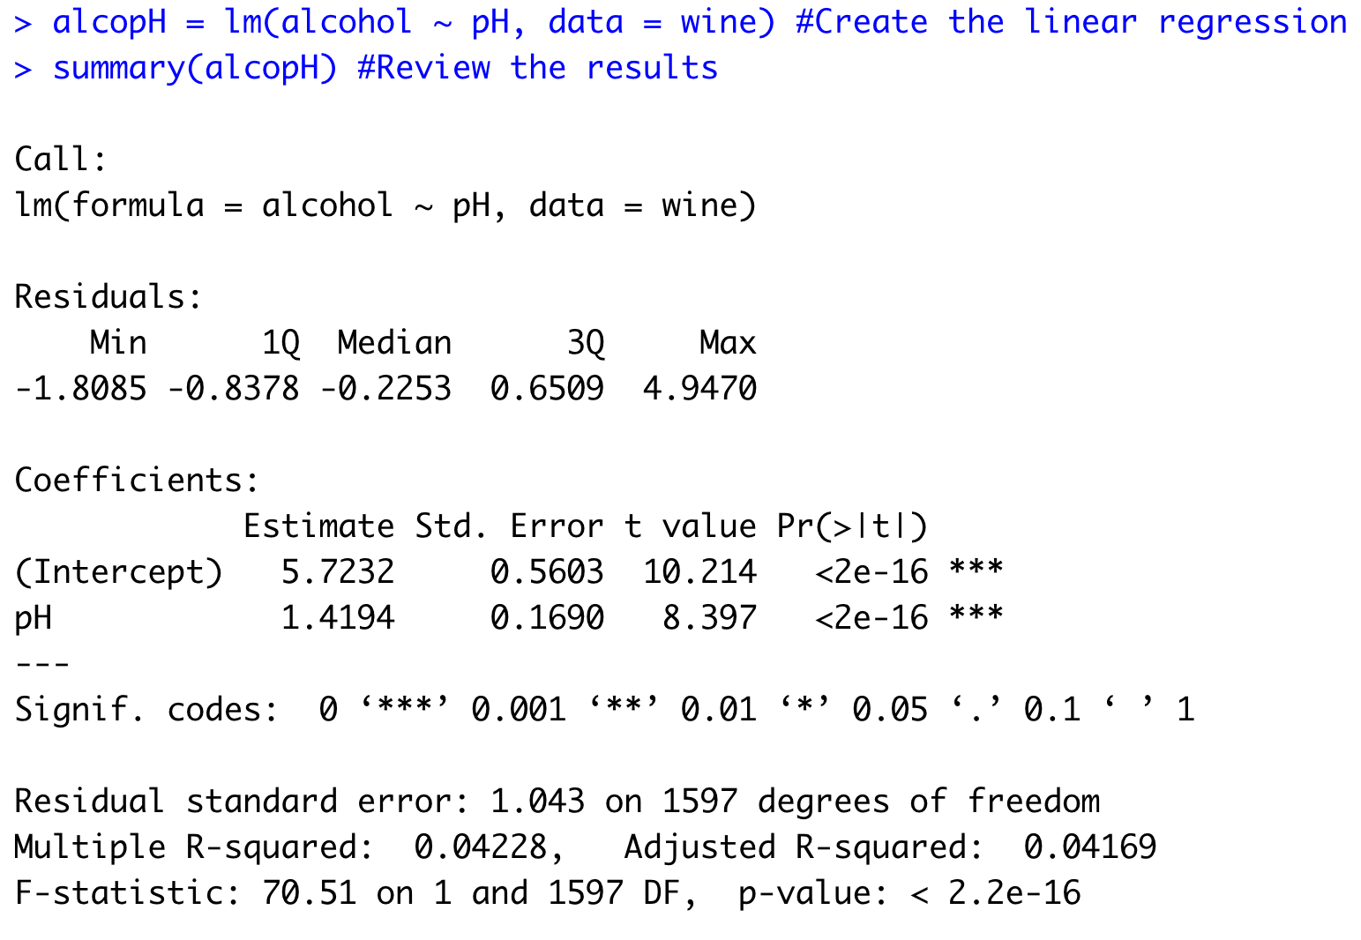
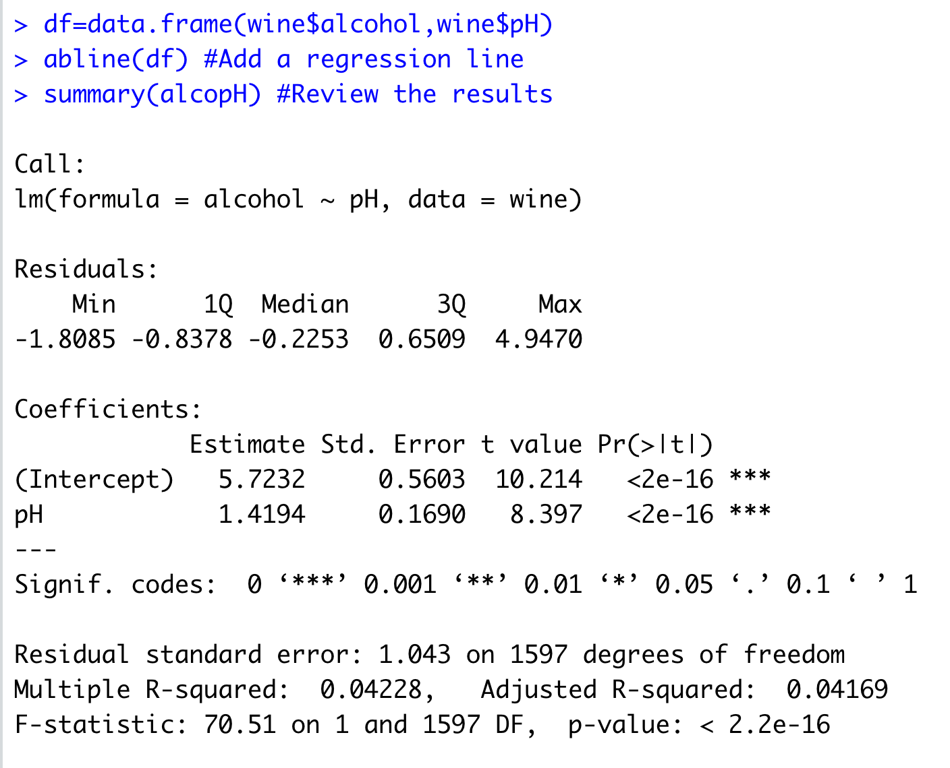

Slide 10
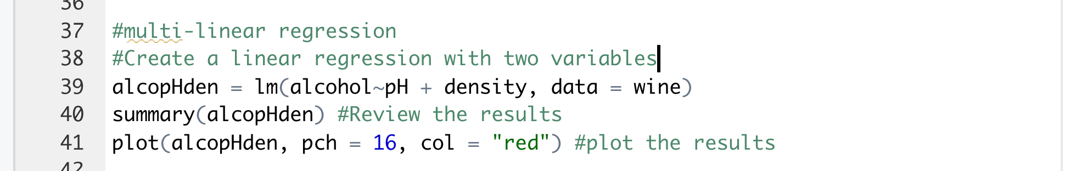
MUTLI LINEAR REGRESSION
Multi-linear regression is a type of linear regression that is used to model the relationship between a dependent variable and multiple independent variables.

Slide 11
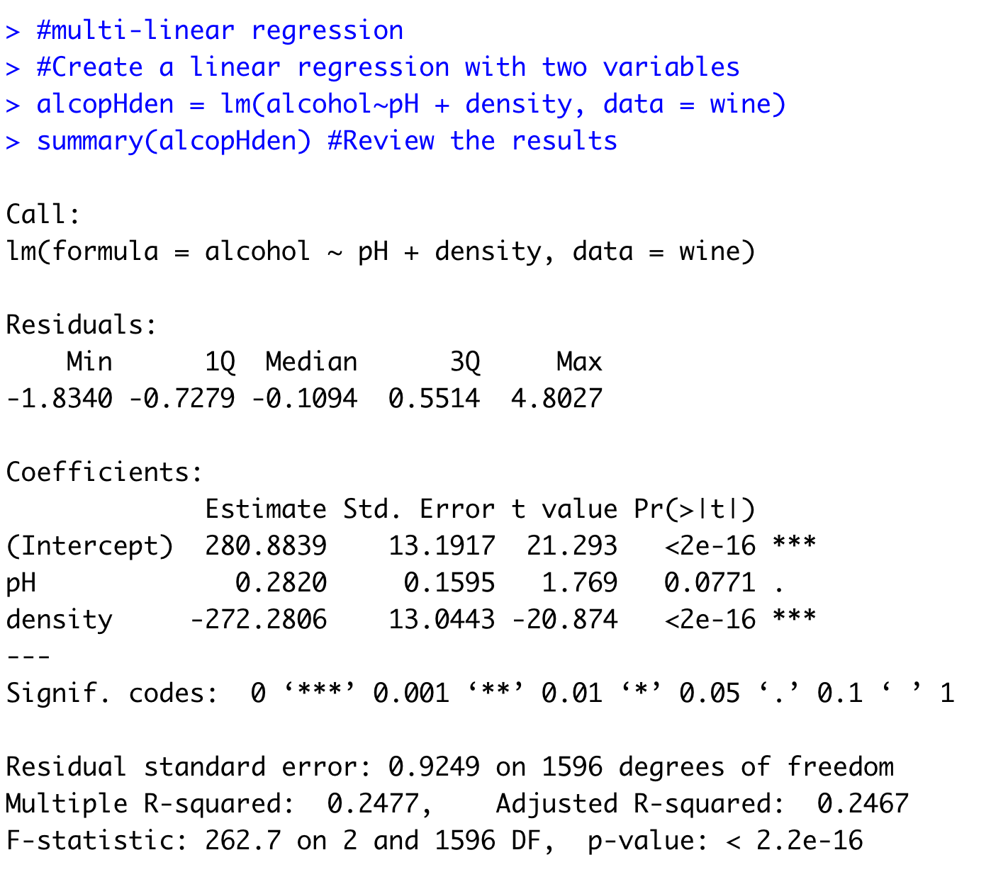

Slide 12
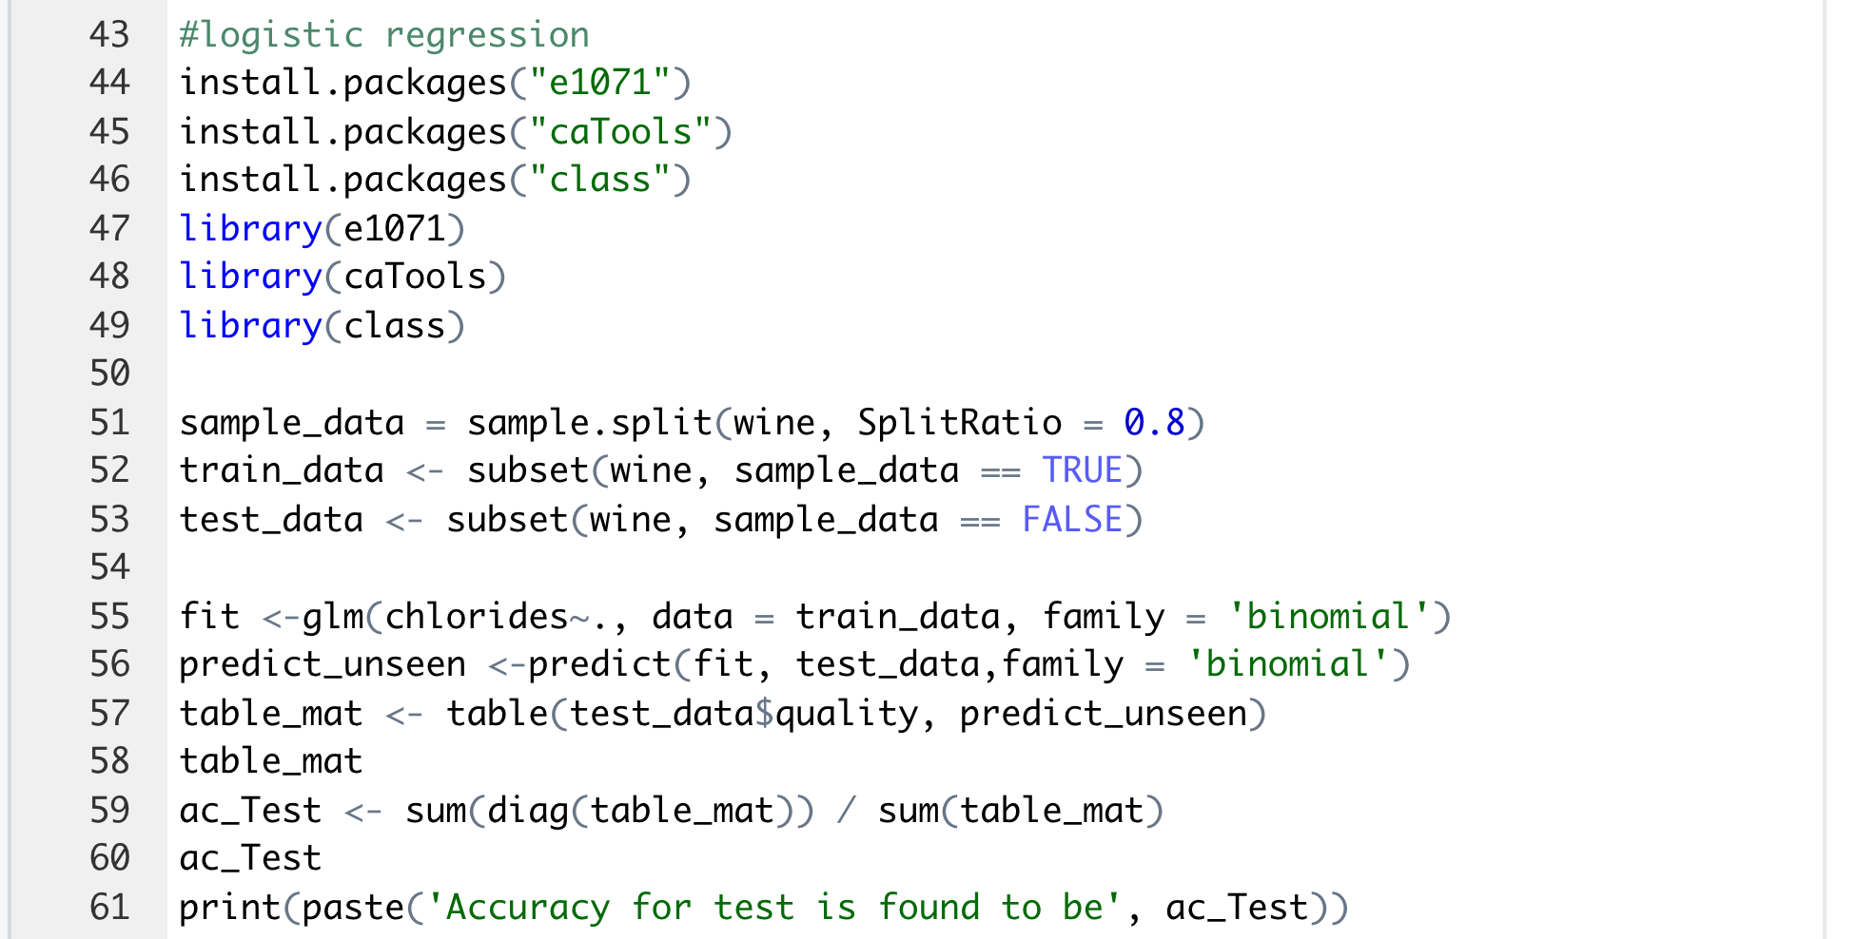
LOGISITIC REGRESSION
Logistic regression is a type of statistical analysis used for predicting a binary outcome (1 / 0, Yes / No, True / False) based on one or more predictor variables.
Steps for logistic regression:
Collect and organize data in a spreadsheet with columns for the independent variable(s) and binary dependent variable
Use a logistic regression software or calculator to find the equation of the logistic curve
Use the equation to make predictions for new data points
Evaluate the model by calculating the Deviance and checking residuals plot
Communicate the results and interpret the coefficients of the equation in the context of the problem.
Examine the goodness of fit by calculating the confusion matrix and evaluating the accuracy, precision, recall and F1 score.
Evaluate the model by calculating the area under the ROC curve.
Identify and handle any outliers and influential points, if any
If necessary, use model selection techniques such as forward and backward selection, stepwise regression and regularization techniques to select the best model.

Slide 13
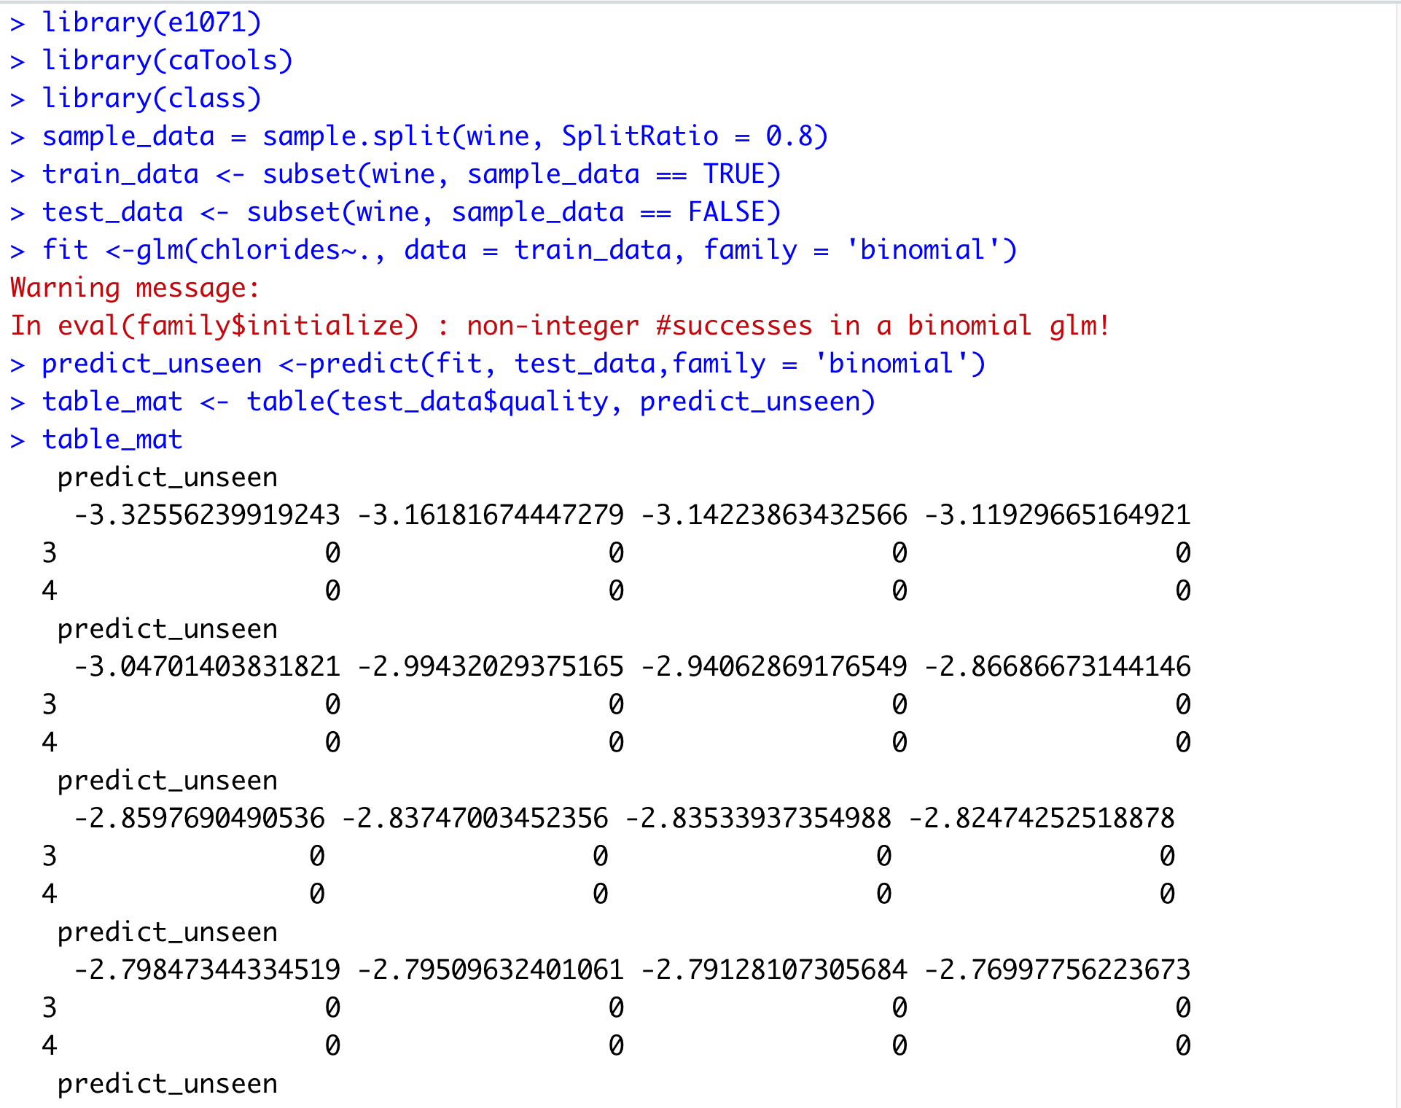
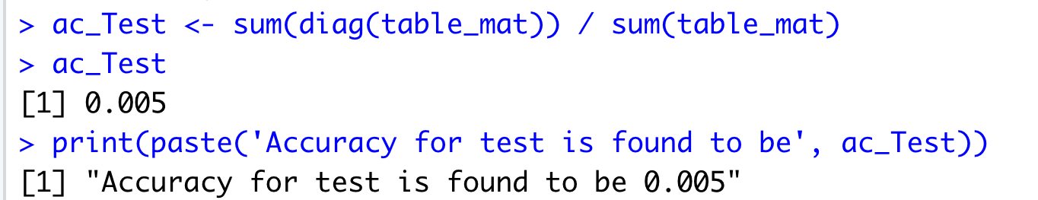

Slide 14
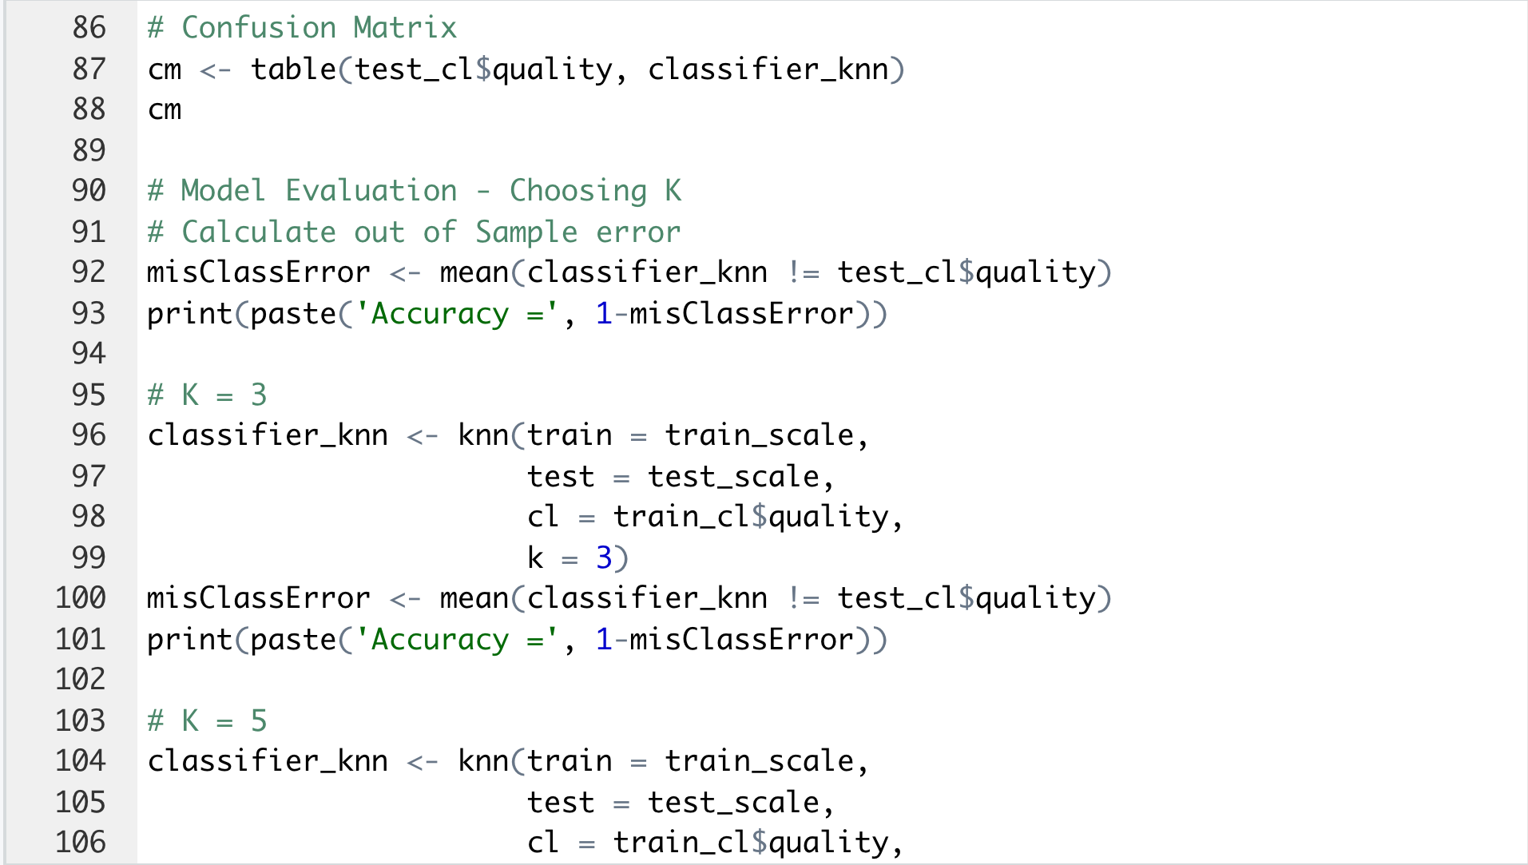
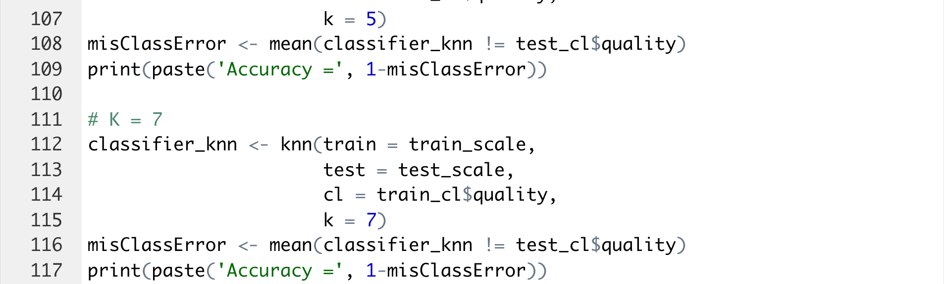
k-NN(k-Nearest Neighbour)
k-Nearest Neighbors (k-NN) is a type of supervised machine learning algorithm used for classification and regression. The basic idea behind k-NN is to predict the class or value of a new data point by looking at the k number of closest "neighbors" from the training data.

Slide 15
Steps for k-NN
Collect and organize data in a spreadsheet with columns for the independent variable(s) and dependent variable
Split the data into a training set and a test set
Choose the value of k (number of nearest neighbors to consider)
For each point in the test set, calculate the distance to all points in the training set
Select the k closest points in the training set
For a classification problem, assign the majority class among the k nearest points to the test point. For a regression problem, assign the mean value among the k nearest points to the test point
Compare the predicted class or value to the actual class or value and calculate the accuracy
Communicate the results, including any limitations and assumptions, to the appropriate audience
Repeat the process with different values of k to determine the best value of k for the problem.

Slide 16
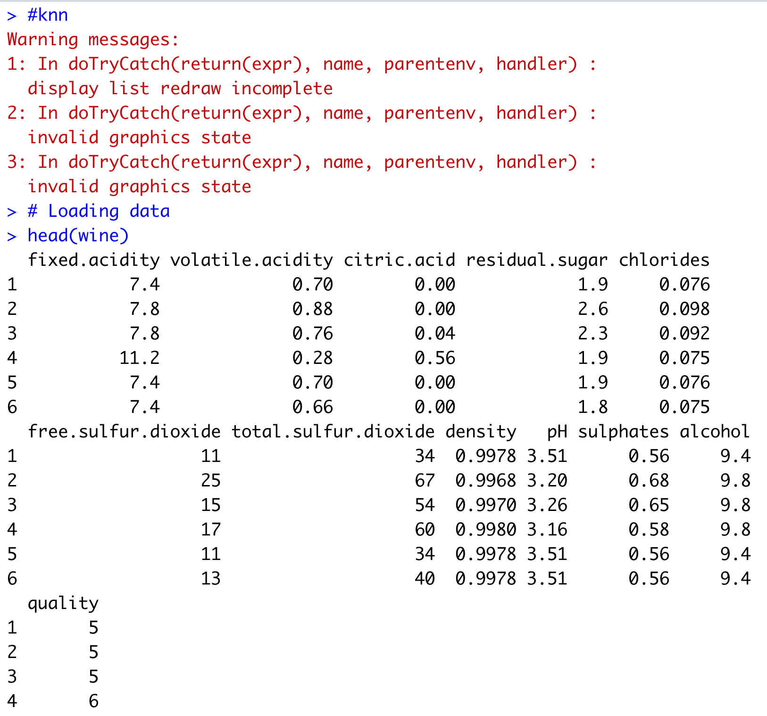
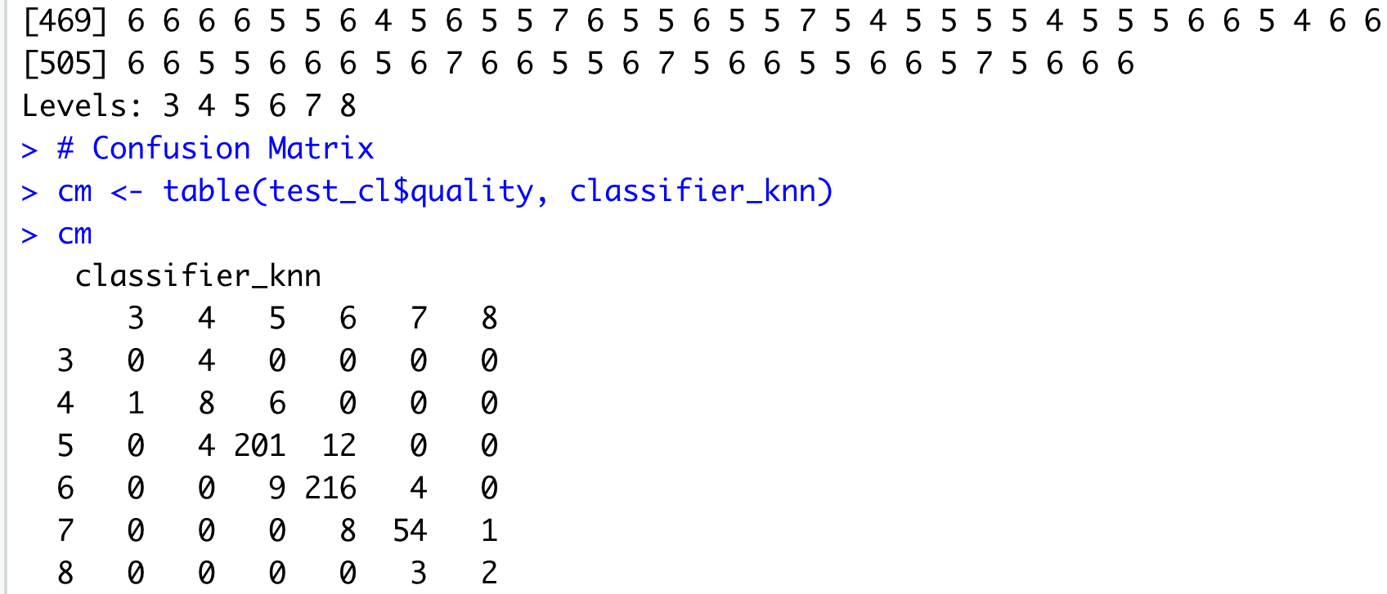
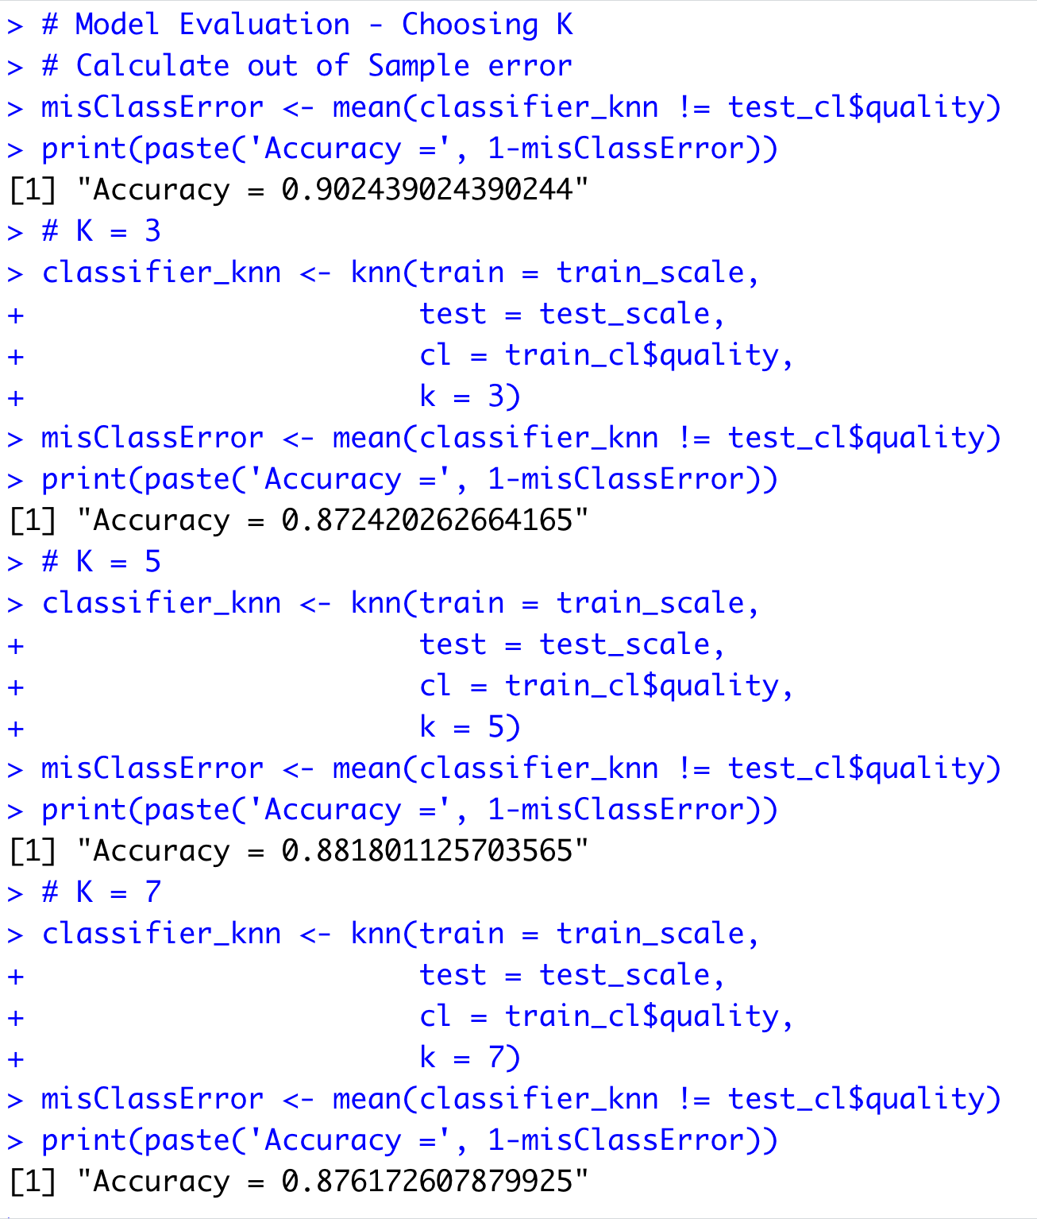
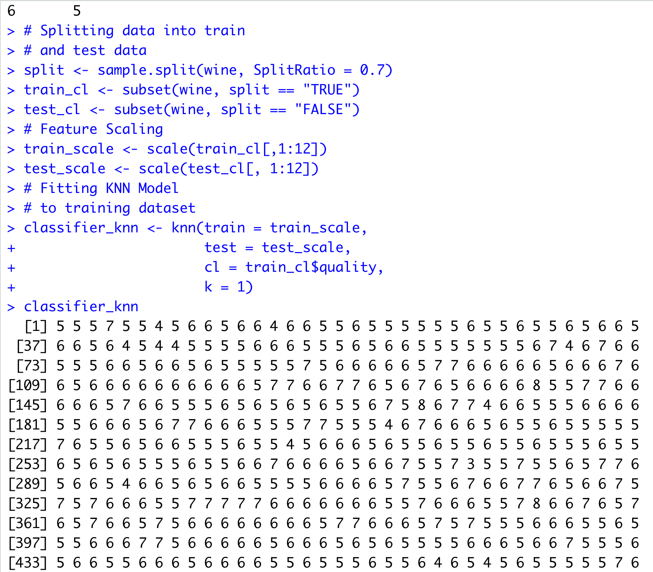

Slide 17
THANK YOU

